Slide 1
05 - Composition of Functions
How do we put functions inside of each other to create more sophisticated images?

Slide 2
agenda
3 min - Transition from previous class 3 min - Students signing out laptops/setting up files 3 min - Students working on warm up activity 5 min - Review last class 2 min - go over list of functions students can use in their programs 3 min - write one contract together 5 min - lesson on composition of functions 15 min - focused practice on composing images 2 min - transition to closing 5 min - share student work, 3 min - regroup, summarize, plan for next class
5 min - Exit Form 5 min - Sign out, return laptops, dismiss

Slide 3
error messages
enter the following code exactly how it is written
(circle 50 "solid" "red"
What does the message say?

Slide 4
how about this one?
(circle "solid" 50 "red")
What is the message telling us?

Slide 5
what is the difference between a type and a value?

Slide 6
enter the following code and be prepared to discuss
(define width 100)
(define radius
(* width 1/2))
(define rc
(circle radius "solid" "red"))
1
1
3
4
6
7

Slide 7
composition of functions: putting one function inside of another
Interpret the following line of code.
(* 5 (+ 3 2))
...and this one?
(rotate 45
(triangle 50 "solid" "green"))
How many parameters does rotate have? How do we answer this question?

Slide 8
locating images relative to each other
Go to the Designing Structure Worksheet

Slide 9
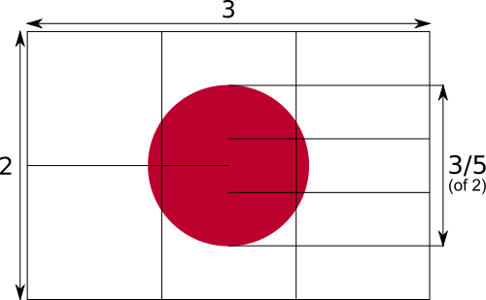
flag of japan
The width is 3 or a multiple of 3.
The height is 2 or a multiple of 2.
The diameter of the circle is three fifths of the height.

Slide 10
This makes an image...
(place-image
(circle 60 "solid" "red")
150 100
(rectangle 300 200 "outline" "black"))

Slide 11
but this is a program.
Go to Japan Flag Good to see an example of program.

Slide 12
Mr. Allatta's U.S. Flag Program
Go to http://www.wescheme.org/openEditor?publicId=tCt9uyrglj
Extension: Look for a better way to create the stars.

Slide 13
"You know you are done when your code is as beautiful as the flag it creates," Emmanuel Schanzer, creator of WeScheme

Slide 14
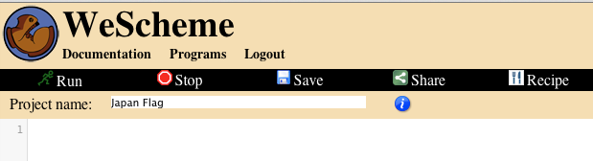
login to WeScheme
start a new program called Japan Flag

Slide 15

we want to create the following image
What do we need to know about it?
height, width, size, components

Slide 16
first we need to think about the pieces
The width is 3 or a multiple of 3.
The height is 2 or a multiple of 2.
The diameter of the circle is three fifths of the height.
A black outline
A white rectangle
A red circle

Slide 17
lets write some code for each piece
;The black outlined rectangle
(rectangle 300 200 "outline" "black")
;The white solid rectangle
(rectangle 300 200 "solid" "white")
;The red solid circle
(circle 60 "solid" "red")
1
2
4
5
6
7

Slide 18
now we need to put it together
how does it fit together?
we place the circle onto the outline and place them both onto the white background

Slide 19
now that we know what to do, lets write the code
This place-image function is actually happening first.
(place-image
(circle 60 "solid" "red")
150 100
(place-image
(rectangle 300 200 "outline" "black")
150 100
(rectangle 300 200 "solid" "white")))
What is the type of value of this place-image function? An image.
This whole place-image function is the 4th parameter of the first place-image function.
What does the inside place-image function do?
What does the outside place-image function do?

Slide 20
add comments to help others understand your code
; a comment in Racket begins with a semi-colon.
; this place image-function place a red circle on a black outline, on a white background.
(place-image
(circle 60 "solid" "red")
150 100
(place-image
(rectangle 300 200 "outline" "black")
150 100
(rectangle 300 200 "solid" "white")))

Slide 21
make your own flag
write a program that displays a flag using two place-image functions. Plan your flag on the worksheet before you begin coding.

Slide 22
extension
for an image that is not cropped by a scene use overlay/xy
other function to incorporate in your program:
flip-horizontal, flip-vertical, scale, scale/xy, above, below, rotate, bitmap/url

